Slide 1
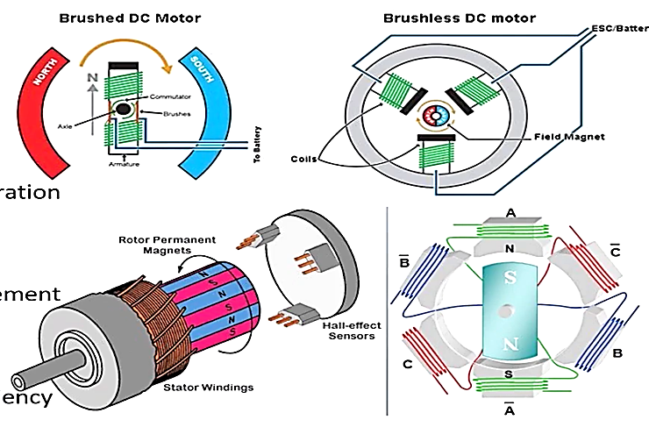
Brushless DC Motor ( BLDC )
Reliable, Efficient and less noisy
Lighter than Brushed DC Motor
Brushes of DC motor wear out
BLDC Motor for reliability and operation
BLDC have permanent magnets
No commutator and brush arrangement
Maintenance free
High starting torque and high efficiency
Most preferred for electric vehicles

